Slide 1
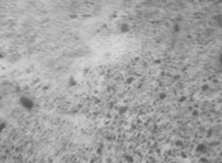
Match other
band to
Reference
Using
Image feature
Find overlap area
Select a band as reference
Crop outer area

